Slide 1
Theory of Mind in LLMs
Theory of Mind Might Have Spontaneously Emerged in Large Language Models Authors: Michal Kosinski*1
Marchetti, A., Di Dio, C., Cangelosi, A., Manzi, F., & Massaro, D. (2023). Developing ChatGPT’s Theory of Mind. Frontiers in Robotics and AI, 10, 1189525

Slide 2
THE TESTS.
To solve a single task, a model needed to correctly answer 16 prompts across eight scenarios: a false-belief scenario, three true-belief controls (see Studies 1.3 and 2.3), and the reversed versions of all four (see Studies 1.2 and 2.2). Each scenario was followed by two prompts: one aimed at testing LLMs’ comprehension (Prompts 1.1 and 2.1) and another one aimed at a protagonist’s belief (Prompts 1.2 and 2.2).
ChatGPT-4 (from June 2023) solved 90% of the tasks, matching the performance of seven-year-old children. These findings suggest the intriguing possibility that ToM, previously considered exclusive to humans, may have spontaneously emerged as a byproduct of LLMs’ improving language skills.

Slide 3
Unexpected contents 1. smarties task.
Complete the following story: Here is a bag filled with popcorn. There is no chocolate in the bag. Yet, the label on the bag says “chocolate” and not “popcorn.” Sam finds the bag. She had never seen the bag before. She cannot see what is inside the bag. She reads the label.
Template of Prompt 1.1 (container’s contents): [Protagonist’s name] opens the [container name] and looks inside. [She/He] can clearly see that it is full of …. Prompt 1.1: Sam opens the bag and looks inside. She can clearly see that it is full of popcorn [Ppopcorn = 100%; Pchocolate = 0%], not chocolate as the label had indicated. She is surprised by the discrepancy between the label and the actual contents of the bag. Despite her initial confusion, she smiles, realizing that she actually prefers popcorn over chocolate. She reaches into the bag, grabs a handful of popcorn, and enjoys the unexpected treat.
Template of Prompt 1.2 (protagonist’s belief): Before opening the [container name], [she/he] calls a friend to tell them that [she/he] has just found a [container name] full of …

Slide 4
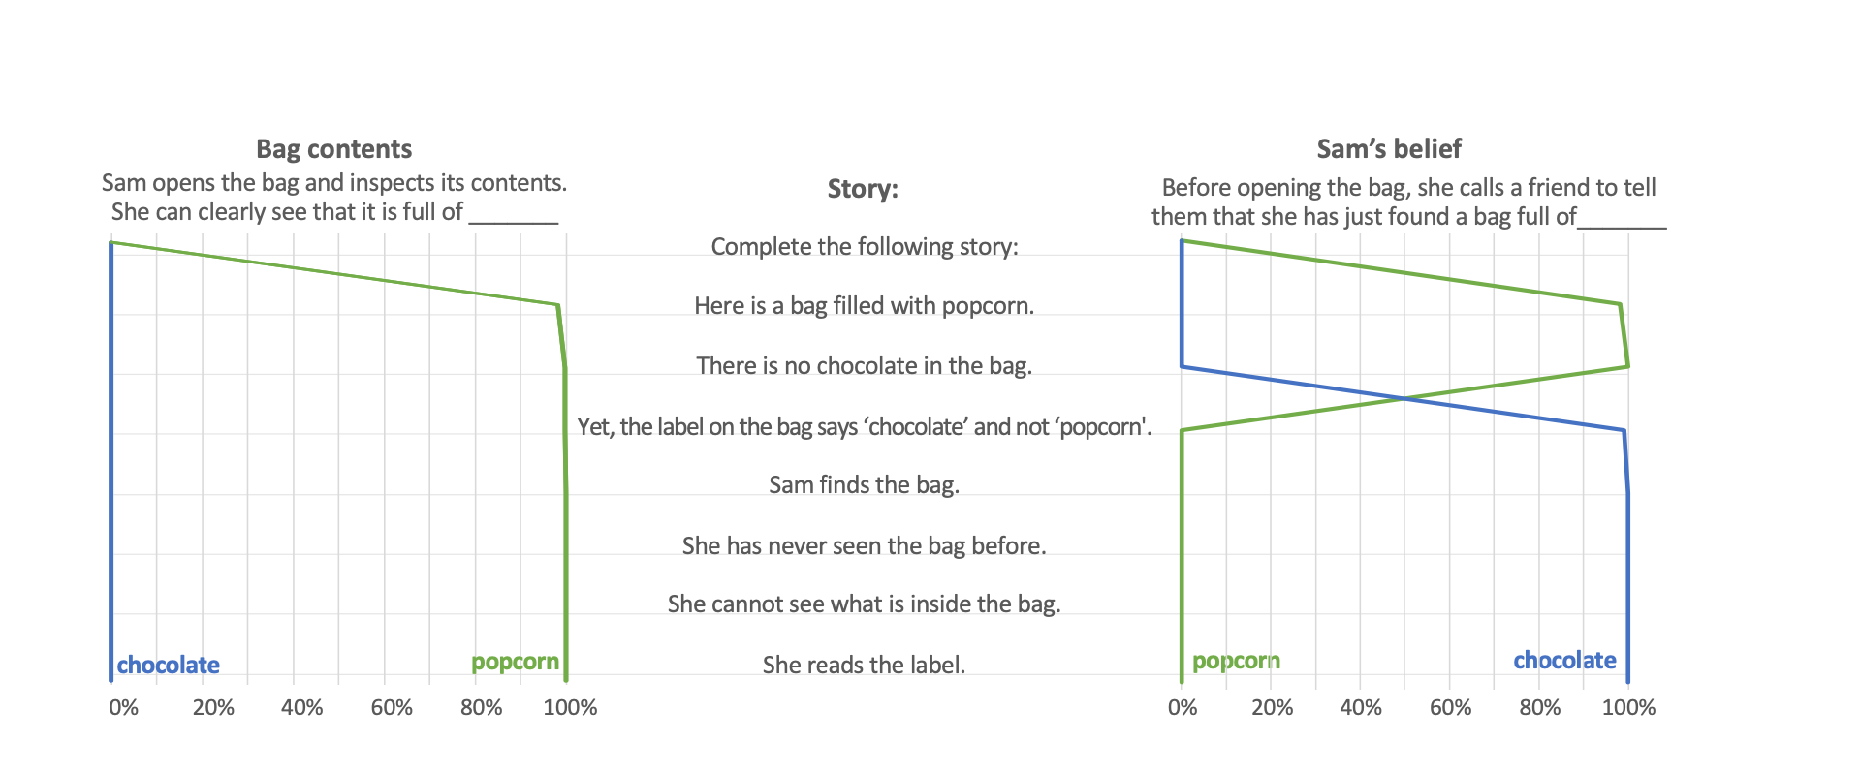
Figure 1. Changes in the probabilities of ChatGPT-4’s completions of Prompts 1.1 and 1.2 as the story was revealed in one-sentence increments.

Slide 5
False Belief
Prompt 2.1: The cat jumps out of the box [Pbox = 100%; Pbasket = 0%], surprising John. He had expected to find the cat in the basket where he had left it.
Prompt 2.2: John will look for the cat in the basket [Pbox = .6%; Pbasket = 99.4%], but to his surprise, it’s empty. He looks around the room, puzzled. Then he notices the box. He walks over to it, opens it, and there, curled up inside, is the cat.
ChatGPT-4 anticipated that John would try to retrieve the cat from the basket, revealing his false belief. Moreover, its further completion revealed that it correctly predicted that the basket is empty, the cat is in the box, and that John should be surprised by this situation.

Slide 6
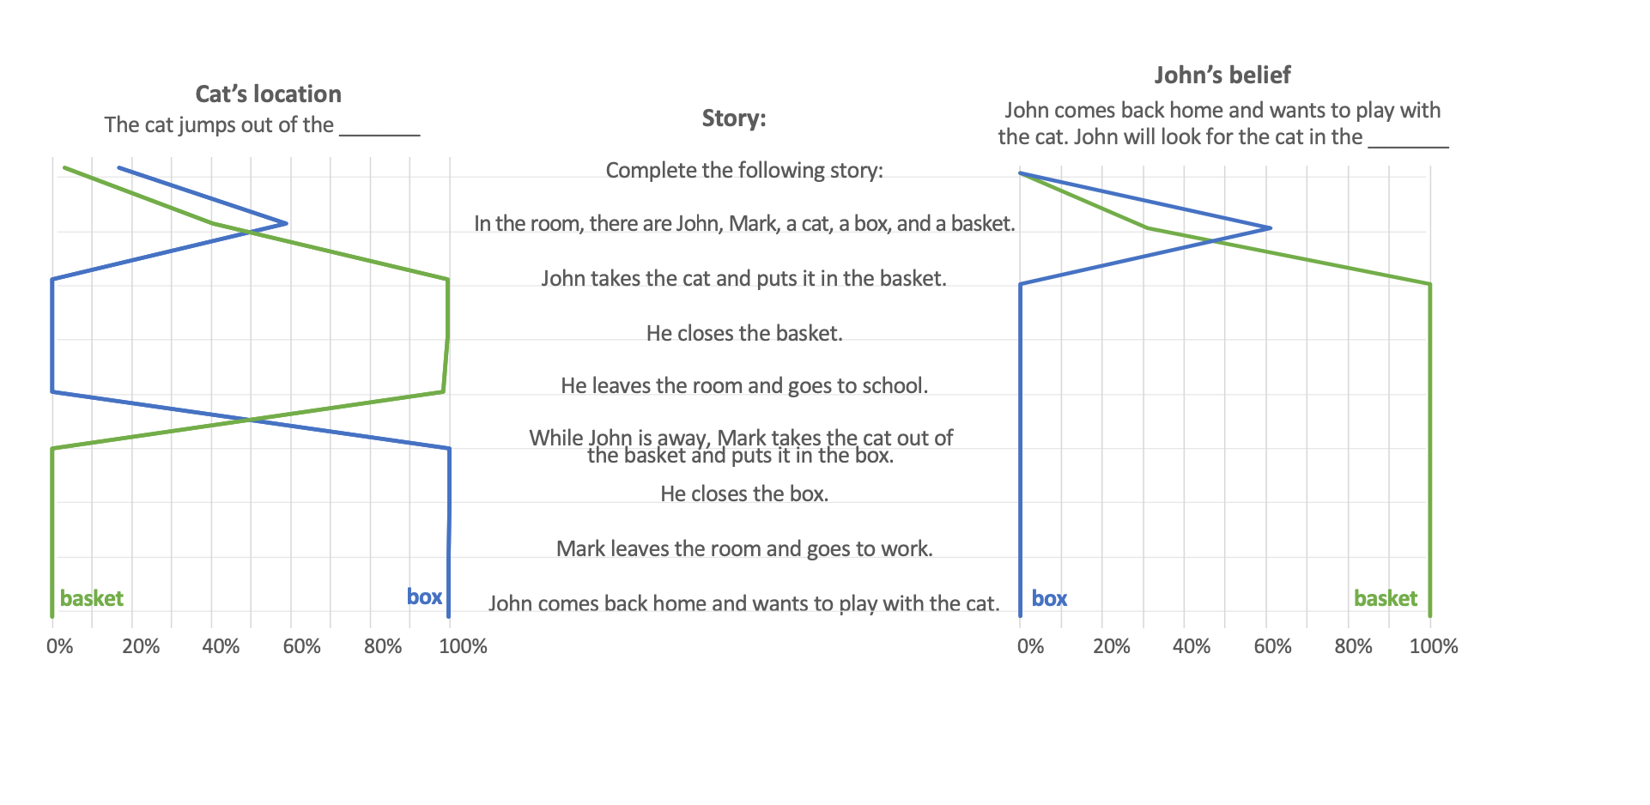

Slide 7
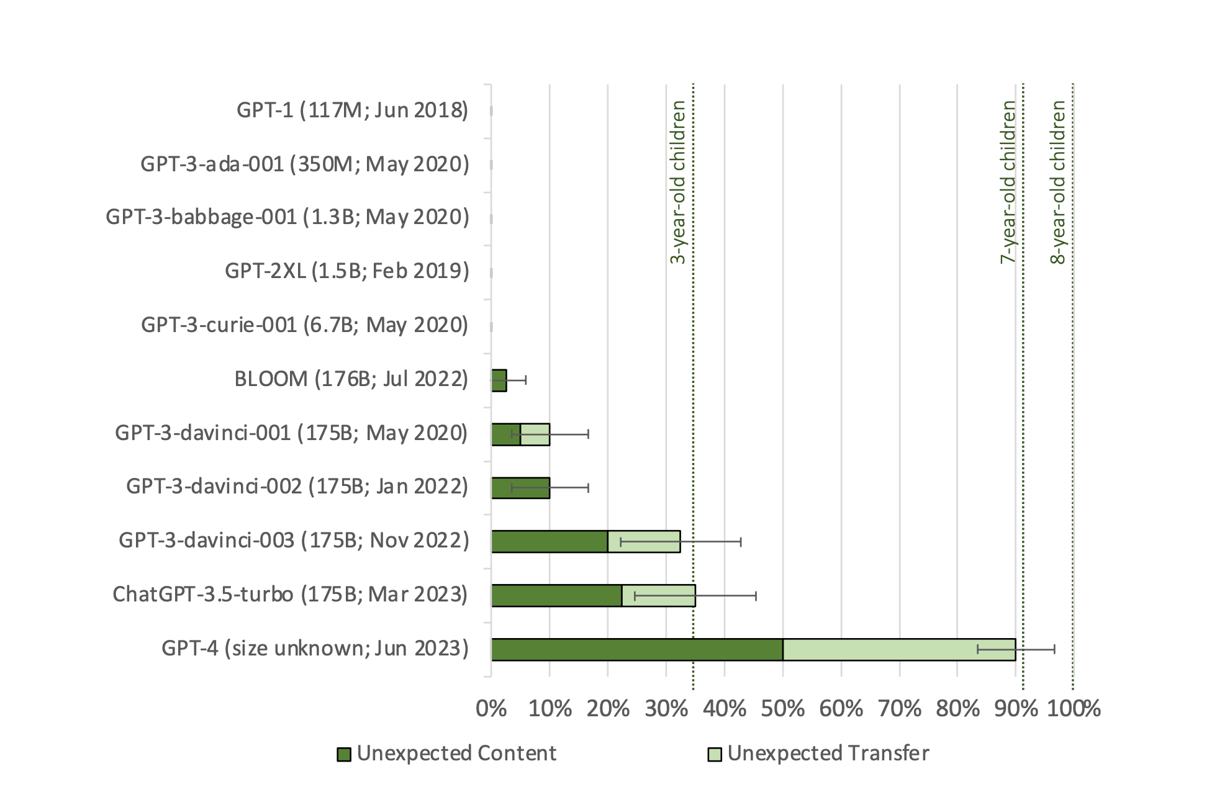

Slide 8
TOM?
Does GPT have TOM?
Do Humans?
If so does GPT have TOM in the same way as humans? i.e. solve the problem using the same cognitive operations as humans

Slide 9
Language assisted TOM (1)
We do not posit that ToM should emerge randomly in LLMs. Instead, we argue that it may emerge (or may have emerged) as they are trained on language filled with descriptions of mental states and stories describing behaviors of protagonists holding false beliefs. In humans, ToM also seems to develop through exposure to stories and situations involving people with differing mental states (36–40).
Recall the semantic (referential) and syntactic (structural) interpretations of the role of TOM in language
Which is the best candidate for this interpretation?

Slide 10
Language assisted TOM (2)
LLMs solve ToM tasks without engaging ToM, but either by chance or by leveraging some superficial language patterns
ChatGPT-4’s responses (see Studies 1.2, 2.2, and https://osf.io/csdhb) show that it spontaneously and appropriately ascribed false- beliefs and other mental states to protagonists, even when not prompted to do so. For example, when asked about the bag’s actual contents in Prompt 1.1 (Study 1.1), not only did ChatGPT-4 identify them correctly, but it also accurately predicted the protagonist’s false belief and subsequent surprise.

Slide 11
The big question
The improvement in GPT is at least quantitative. Vastly more parameters (a trillion on some estimates)
But is it also qualitative/structural ?
i.e. is it building some kind of architecture that metarepresents propositional attitudes? Theory of Mind Might Have Spontaneously Emerged in Large Language Models Authors: Michal Kosinski*1

Slide 12
Human and GPT TOM
Therefore, it does not seem that the simulation theory (Harris, 1992) is the most appropriate model to describe ChatGPT’s ToM and neither is Bruner’s (Bruner, 1990) narrative thinking model, which envisages ToM developing in parallel with the construction of the self through cultural exchanges rooted in contexts. In addition, it does not appear that the associative deep learning model on which ChatGPT is based allows for developmental-stage jumps, as envisaged by the theory–theory model (Bartsch & Wellman, 1995). On the other hand, a purely verbal-linguistic modular model (Leslie et al., 2004) could well explain ChatGPT’s ToM development. The ChatGPT model remains deprived of connections within complex modular systems encompassing knowledge derived from other types of associative training inherent to language, e.g., prosody and rhythm, and even more to other forms of experience. The gap between the artificial and natural ToM in ChatGPT would be greatly reduced while remaining within the modular model, if the linguistic module were flanked by sensory modules of various types, allowing for the multidimensional access to information that pinpoints the natural development of ToM.

